Slide 1
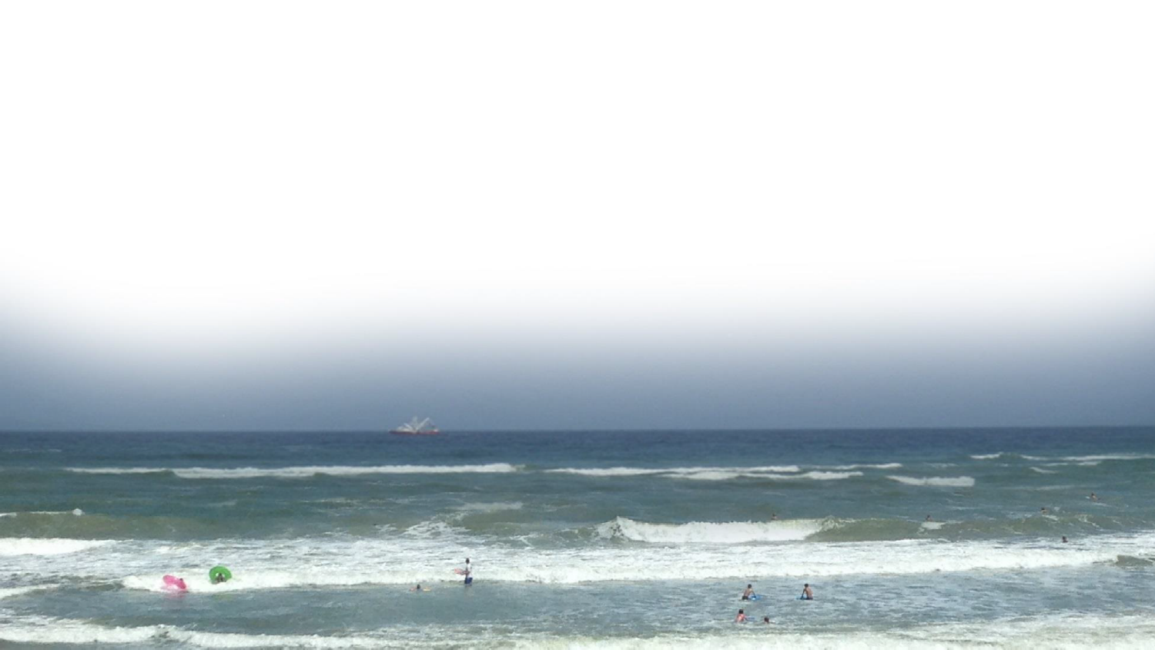
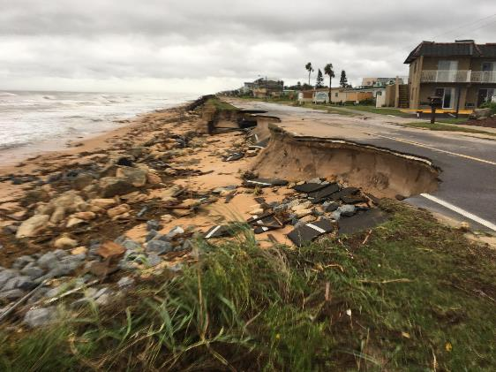


FLAGLER COUNTY, FLORIDA
Coastal Storm Risk Management Project (CSRM) for Flagler County, FL
Flagler County Commission Briefing
U.S. Army Corps of Engineers
Jacksonville District
Presented by: Jason Harrah, Project Manager
June 17, 2019

Slide 2
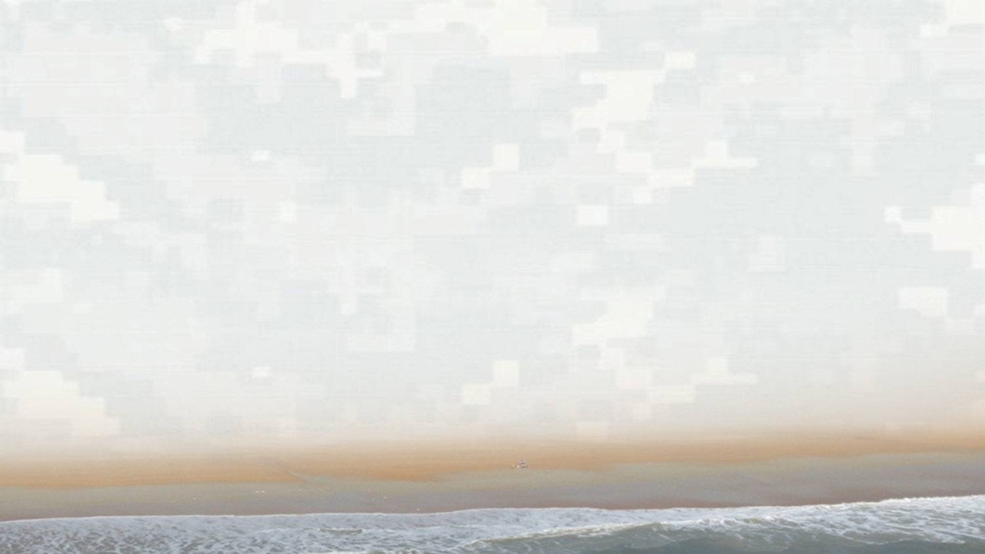
Project Overview
    50 Year Authorization: Water Infrastructure Improvements for the Nation Act of 2016
    Appropriations: $17.5 million (total fed/non-fed amount) received in 2018 Supplemental Bill
    Location: ~3 miles of Flagler Beach Shoreline (north side of 6th Street to south side of 28th Street)
    Design: Includes reconstruction and extension of dune footprint (prior to Hurricane Matthew)
      Existing elevation of dune ~19 ft. NAVD88
      Construction of dune will result in additional “towel space” wider beach berm after initial construction
      Native beach slopes/grades will be maintained
      Approximately 550,000 cubic yards of sand will be placed for initial construction
      Approximately 400,000 cubic yards of sand will be placed for each 11 year renourishment
    Construction Schedule:
      Initial Construction 2020
      1st Renourishment 2031
      2nd Renourishment 2042
      3rd Renourishment 2053
      4th Renourishment 2064
2014 quantity for initial 330,000 cubic yards (updated to address Hurricane Matthew impacts)
Project becomes eligible for emergency beach repair funding after initial construction

Slide 3
Project Benefits
Economics
Environmental
      Nesting habitat (~ 3 acres created)
      Shelter (protection from predators)
      Food source (for various wildlife)
      Biodiversity (increased plant species variety)
      Reduced Risk of future A1A damages

Slide 4
Project Design
Limits of Project
Typical Cross Section

Slide 5
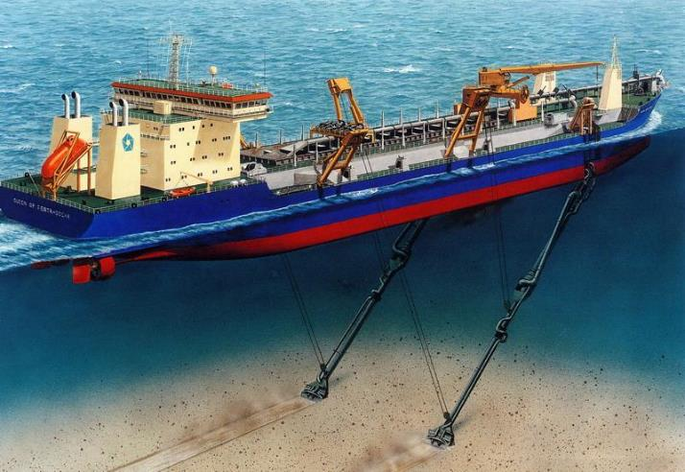
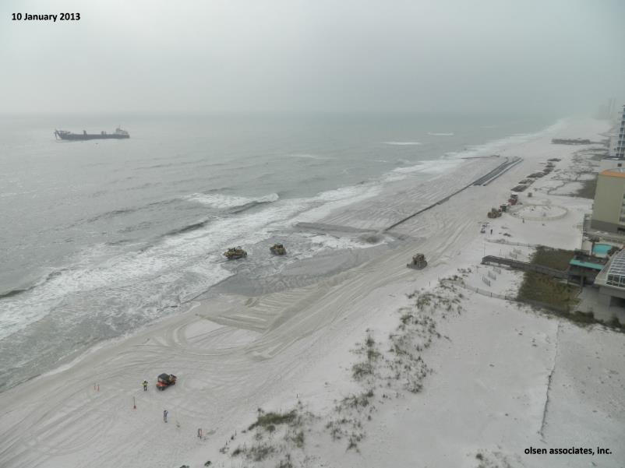
HOPPER DREDGE
Hopper dredge unloading sand to beach
Hopper Dredge
Submerged Line
Shore Line
Hopper dredge loading sand from seafloor
Discharge

Slide 6
Northern Project Limit

Slide 7
Southern Project Limit

Slide 8
Dune Vegetation

Slide 9
Contractor Staging & Access

Slide 10
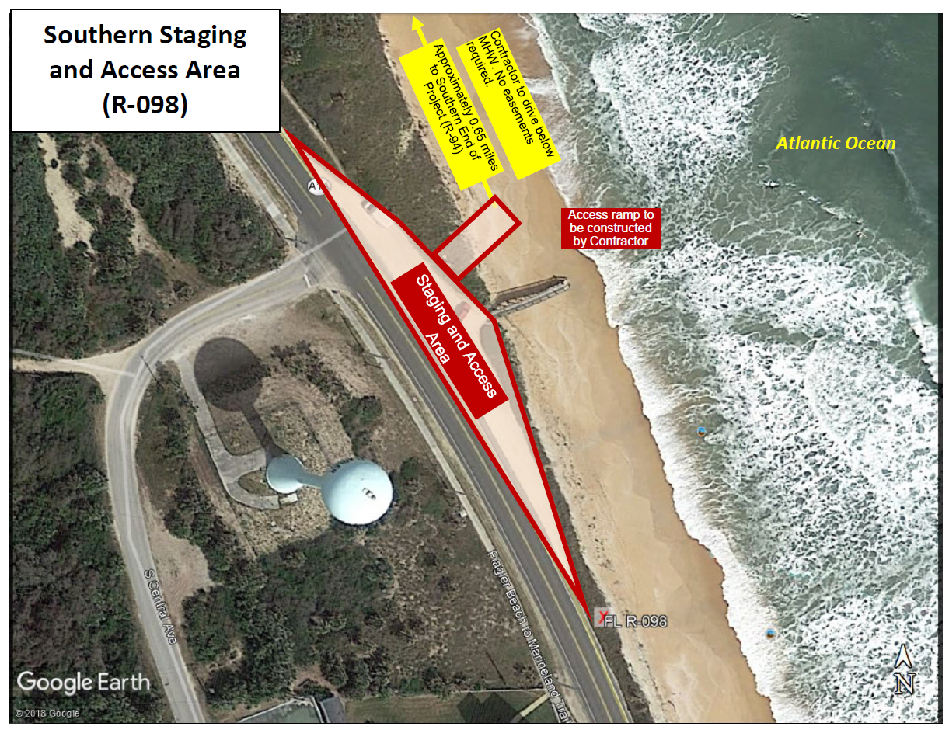
Contractor Staging & Access

Slide 11
Real Estate Requirements
    Overview: The local sponsor of each USACE project (i.e. Flagler County) is required to obtain all lands, easements, rights of way required to construct the project. This includes perpetual storm damage easements, certification of staging/access requirements and FDOT Right of Way Easements.
    1. Staging/Access Requirements: North Beach Access at 3rd Street, South Beach Access near Water Tower
      North Beach Access – Improvements will be made to the existing ramp to allow vehicle access. This access will be used to fuel equipment, etc. Contractor will leave ramp improvements in place if local sponsor desires.
      South Beach Access – Beach parking area will be closed for duration of construction. This access will be used to move equipment, pipe, etc. Contractor will restore any improvements back to original conditions including vegetation, etc.
      Both properties are owned by City of Flagler Beach.
    2. FDOT Perpetual Easement: Easement will allow USACE to construct and restore the dune up to the edge of pavement along A1A. This is critical for each renourishment and recovery after major storm events.

Slide 12


Real Estate Requirements
    Overview: The local sponsor of each USACE project (i.e. Flagler County) is required to obtain all lands, easements, rights of way required to construct the project. This includes perpetual storm damage easements, certification of staging/access requirements and FDOT Right of Way Easements.
    3. Perpetual Storm Damage Easements: Approximately 139 perpetual easements required for the project.
      41 easements from City of Flagler Beach
      98 easements from private residents
State Road
A1A
Mean High Water Line
Private Property
State of Florida Lands
FDOT ROW

Slide 13
Perpetual Easements FAQ
Why are easements required for shore protection projects?
  Perpetual storm damage reduction easements are required by the Federal Government to place sand on private property. Easements allow the temporary construction activities necessary to build the beach and guarantees the public will be able to use the publicly-funded beach after construction.
Can you put an expiration date on easements?
  No. The easement is specifically for the authorized federal project until the project is de-authorized by Congress.
Why are easements perpetual?
  The required easement is a perpetual storm damage reduction easement. It is perpetual because it guarantees that the public will have long-term use of the beach after public funds are spent restoring it. It also ensures that the engineered beach provided for the community at federal expense forever remains open to the public for use and enjoyment.
What happens if I don’t approve an easement over my property?
  Current Federal policy states that in the case of those properties for which an easement is not provided, the Federal government will not share in the cost of sand placed on the beach fronting that property. The local sponsor could choose to:
    (1) ask the Federal government to skip, not fill, that section of the beach;
    (2) absorb the additional local costs;

Slide 14
Perpetual Easements FAQ
How does the easement affect my property rights?
  It does not affect property rights of the upland landowner. An easement is a right of use over limited and specific defined areas of a property. The right of use allows the engineered beach to be built on the property, maintenance of the beach, and public use of the beach in a reasonable and lawful manner.
Does the easement grant the state or US Army Corps of Engineers permission to build structures on my property?
  No, the perpetual easement is specific to the federal project only, which is limited to beach restoration, beach nourishment and beach disposal of high quality sand from navigation projects or adjacent sea beds.
Will the public have the right to use the beach on my property?
  Yes. The Corps requires that the beach remain open to the public for use. The public will be able use the beach on which the easement has been placed in a reasonable and lawful way. It does not, however, turn the beach into a municipal beach that is controlled by the government. It still remains private property. In addition, the public will not be permitted to use any portion of the property beyond restrictions set in the easement. For example, the public is not permitted to traverse the property in order to get to the beach.
Will I retain the right to enjoy my property?
  Yes. The easement only authorizes the Corps to place sand on the property and allows the public to use the beach. It does not prevent you from using your property. It remains privately-owned property , but you cannot prevent the public from using the beach on your property, or tell them they need to move because it is private property.

Slide 15
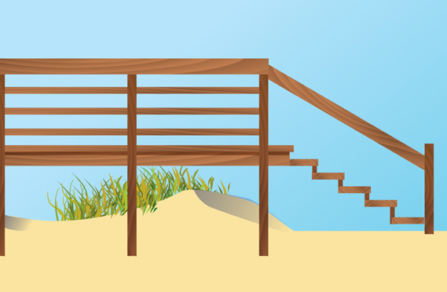
Dune Walkovers
    Approximately 42 walkovers located within the federal project footprint.
    Contractor will place sand on, around and underneath each walkover to maintain continuous protective dune.
    Sand will naturally equilibrate and expose walkover steps over time.
    Photos will be taken of each walkover prior to construction.
    Contractor bonded and insured if damage occurs as a result of construction activities.

Slide 16
Cost Summary
 | Federal Share | Non-Federal Share | Non-Fed Credit for Lands, Easements, ROW | Non-Federal Cash Required | Total Cost
Initial Construction | $11,371,000 | $6,123,000 | ($3,633,000) | $2,490,000 | $17,494,000
4 Periodic Renourishments | $40,652,000 | $40,652,000 | $0 | $0 | $81,304,000
Total Cost | $52,023,000 | $46,775,000 |  |  | $98,798,000
Notes:
The Bipartisan Budget Act (BPA) of 2018 allocated $17.5M (total federal and non-federal share) for initial construction.
BPA allows federal government to pay non-fed share upfront for initial construction (~ $2,490,000) with payback over 30 years w/interest (current interest rate 2.875%).
Payback starts after initial construction is complete to Department of Treasury.
Once initial construction is completed, federal government will repair erosion damages to the constructed beach after approval from USACE HQ.
2014 Chiefs Report provides cost as $44,962,000 which is 2015 price level. PPA provides fully funded cost through 50 year life.

Slide 17
Schedule
29 April 2019 Draft Plans/Specs Complete
17 June 2019 Flagler County Commission Approves PPA
TBD PPA Executed between USACE and Flagler County
03 Jan 2020 Flagler County certifies all lands to USACE
03 Jan 2020 Final Plans/Specs Complete and Certified
27 Jan 2020 Construction Contract Advertised
13 Mar 2020 Bids Opened
21 Apr 2020 Contract Awarded
05 Jun 2020 Construction Starts
31 Dec 2020 Construction Completed (weather pending)

Slide 18
During and After Construction
D
U
R
I
N
G
Contract will stage equipment near the beach (metal pipe, trucks, etc.).
Construction will likely occur 24/7 until complete.
Sand will be pumped onto the beach from offshore and graded into place by bulldozers and other equipment.
Sections of the beach will be closed off while working.
Updated progress maps will be published on social media and local news.
Safety personnel will be on site to direct the general public away from potential hazards.
Beach will naturally reshape and equilibrate.
Escarpments will form along the new template (local sponsor is responsible to remove and maintain beach template).
Dune vegetation will be planted by USACE.
Walkovers will naturally become exposed as sand erodes.
Signs will be posted warning the public to stay off the newly constructed dunes (local sponsor responsibility).
Protection measures will be implemented for new dunes (i.e. fencing, marking areas of walkovers, etc.).
USACE and Sponsor will monitor the beach frequently to determine when renourishment is needed or soon after major storm events.
A
F
T
E
R

